Slide 1
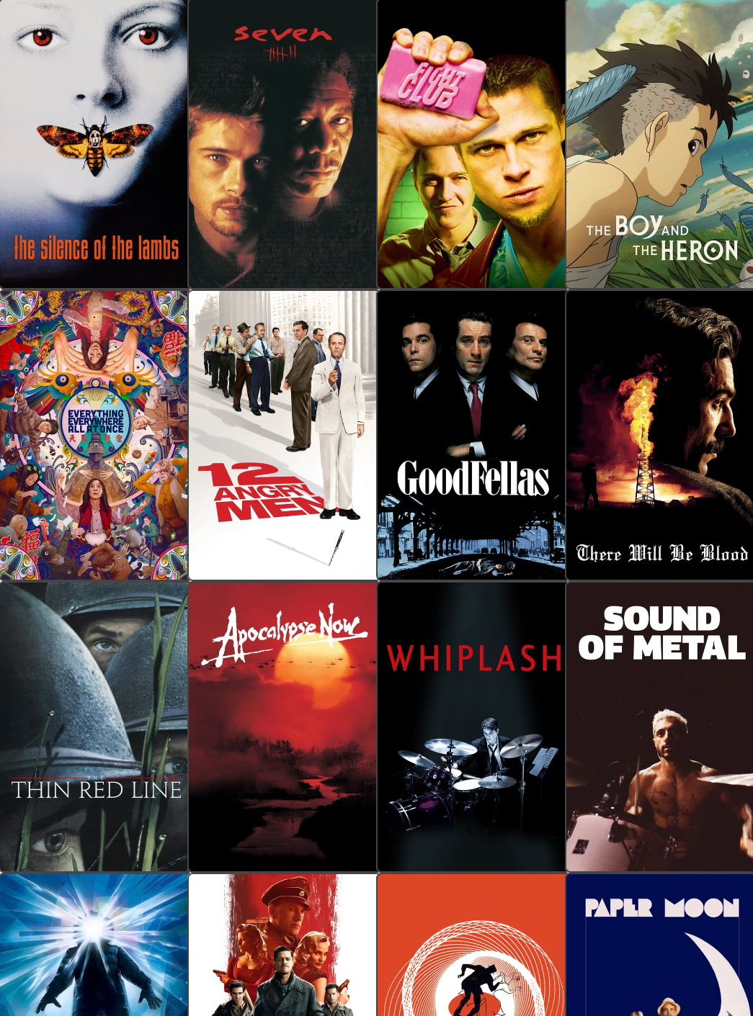
MoviePicker

Slide 2
Features
search for movies
manage a watchlist
vote for movies with friends
choose what to watch

Slide 3
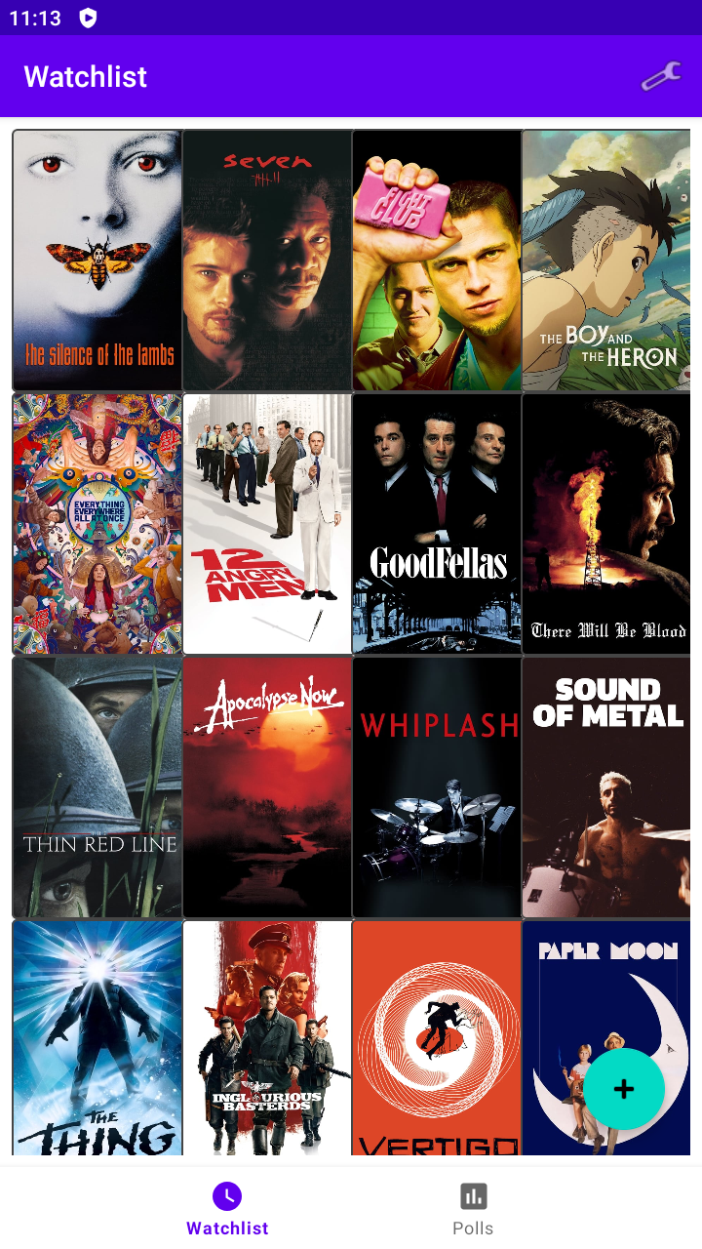
Watchlist

Slide 4
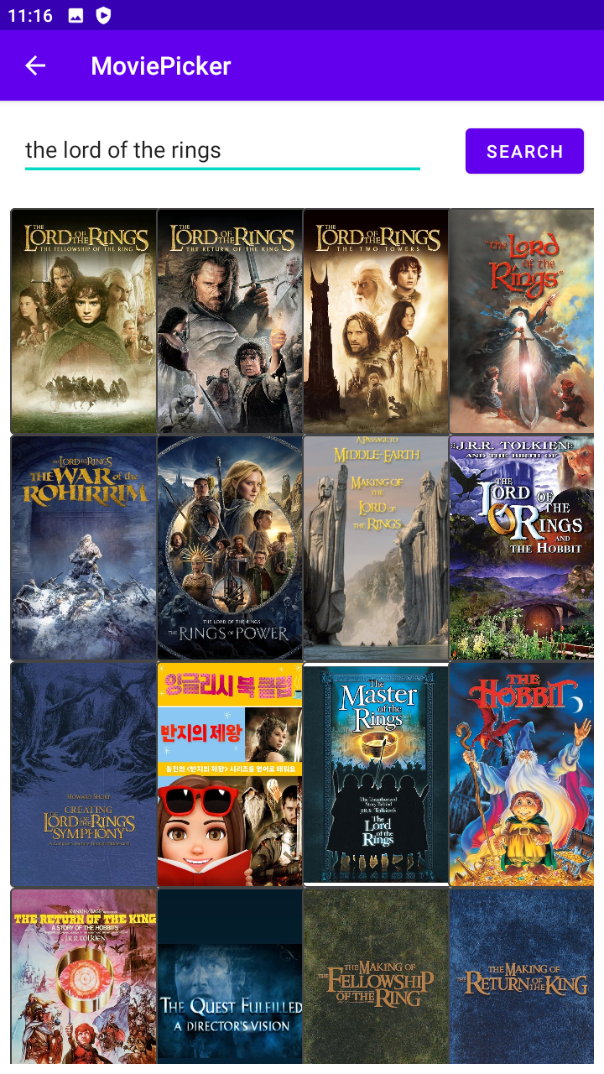
Search

Slide 5
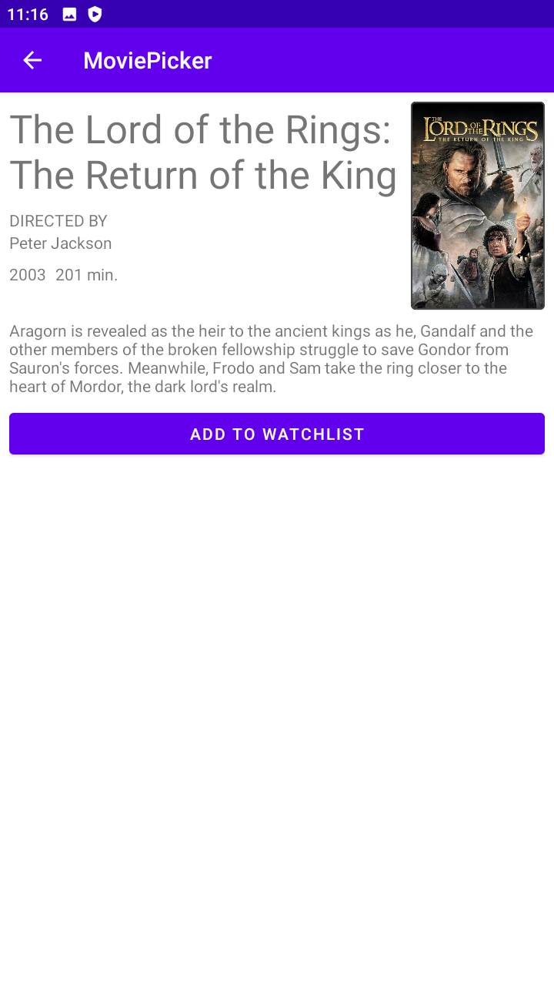
Details

Slide 6

Details (added to watchlist)

Slide 7
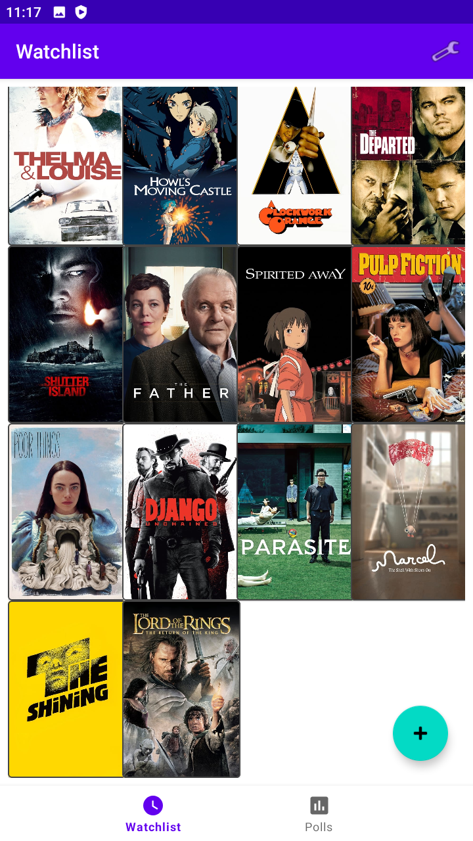
Watchlist (with added movie)

Slide 8
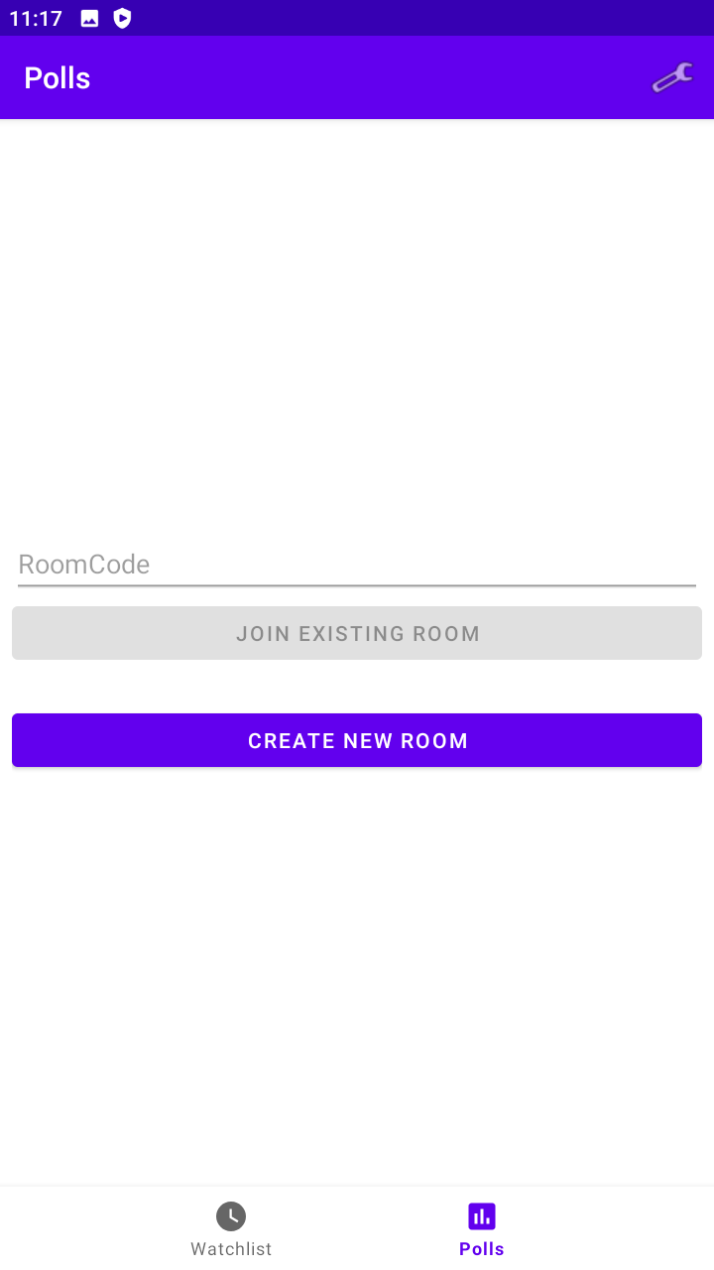
Polls

Slide 9
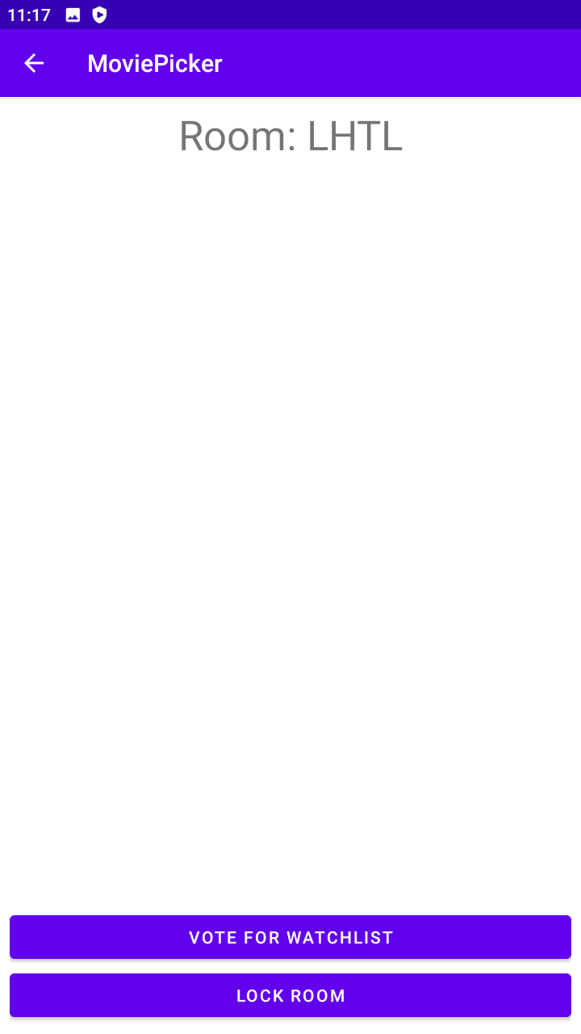
Empty Room

Slide 10
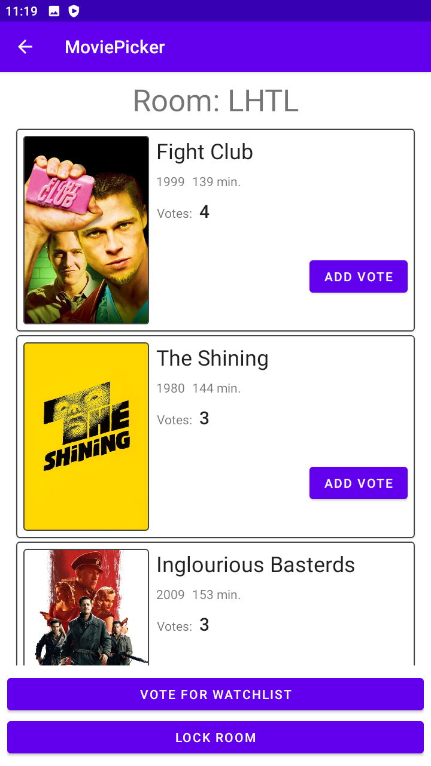
Room (with votes)

Slide 11
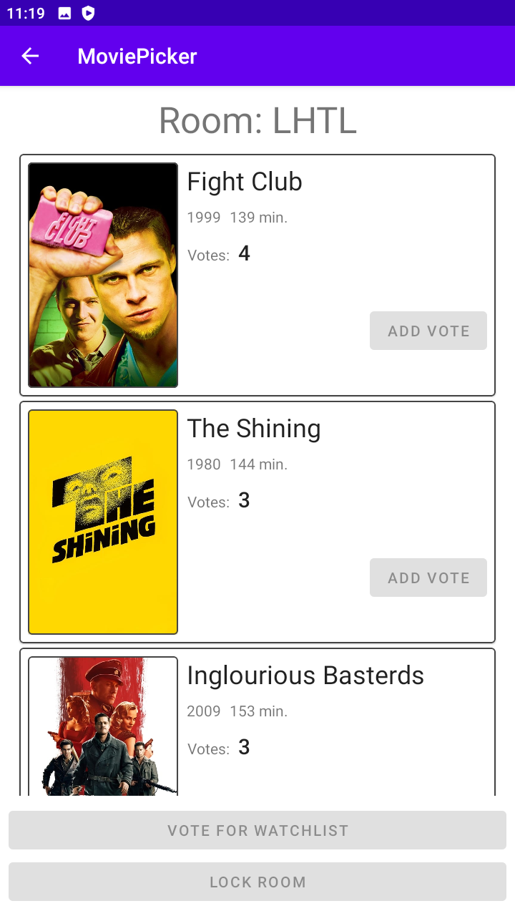
Room (locked)

Slide 12
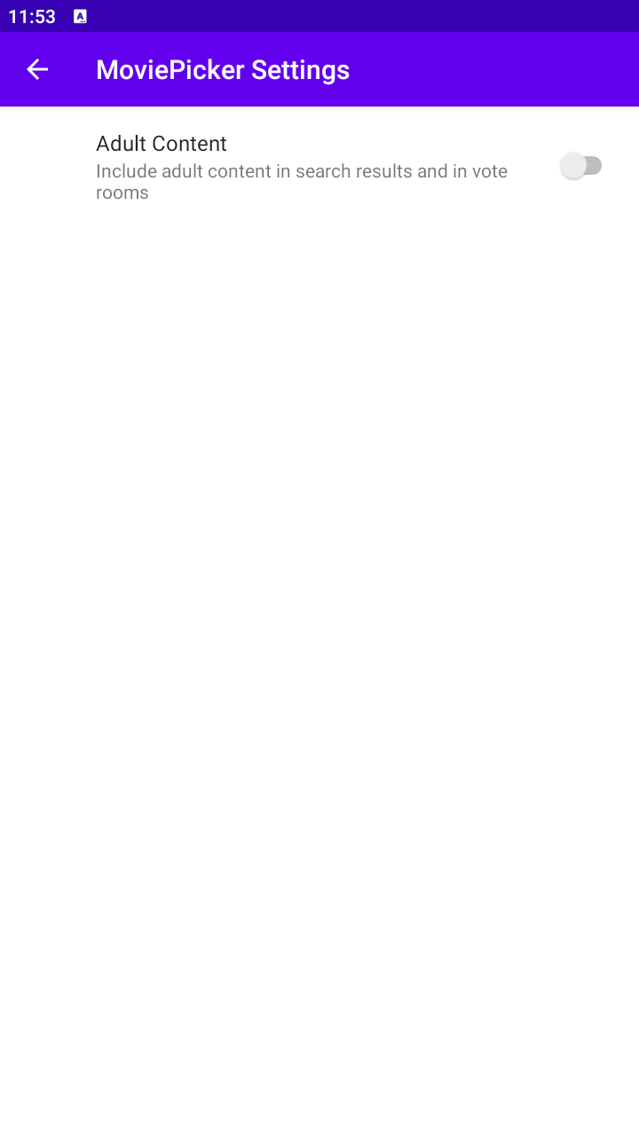
Settings

Slide 13
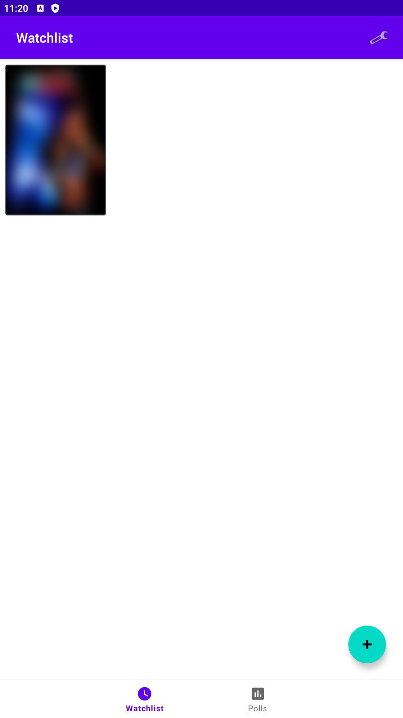
Censored Image

Slide 14

Credits

